Slide 1
Refinement
How to make a plan when you don’t know everything

Slide 2
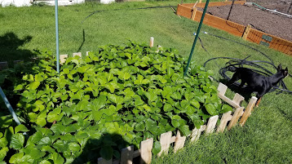
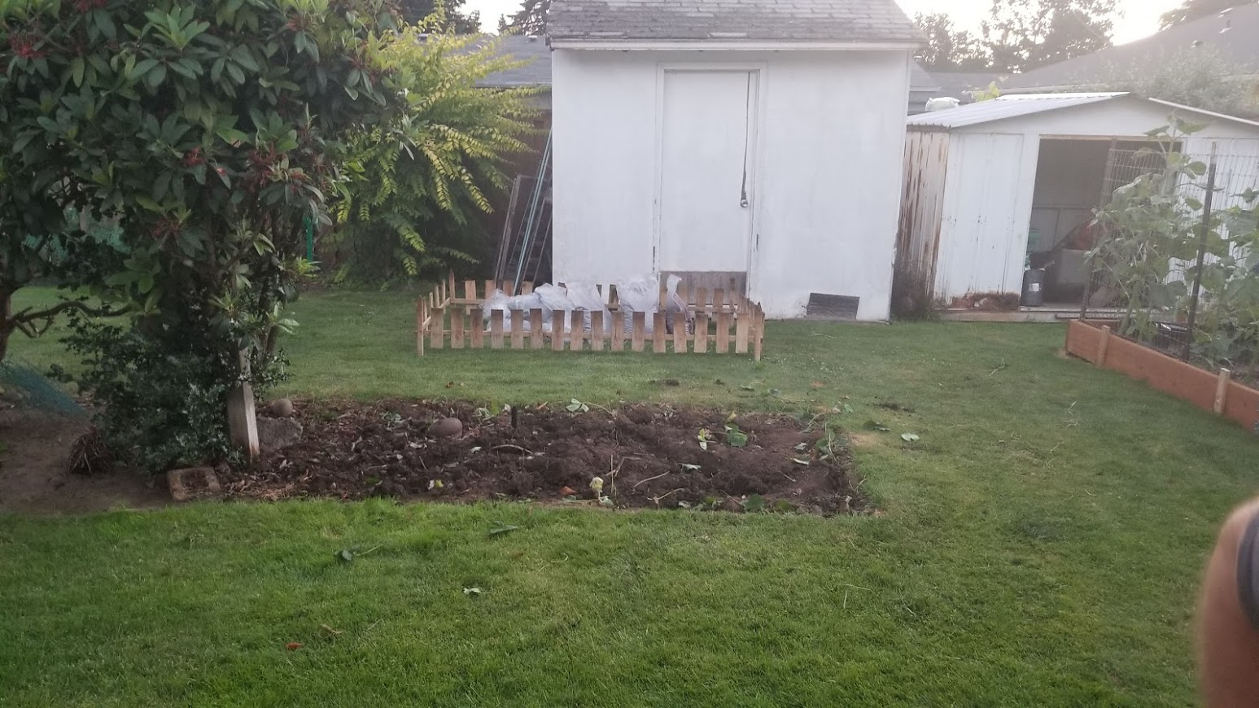

Slide 3

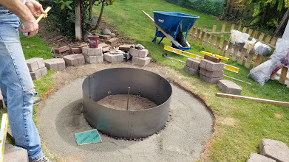


Slide 4
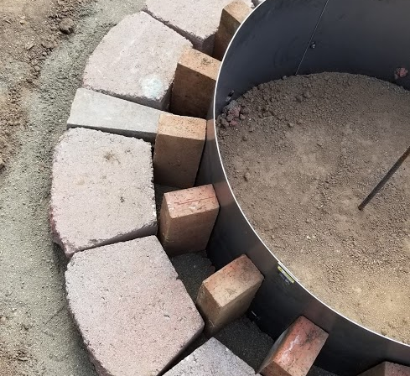
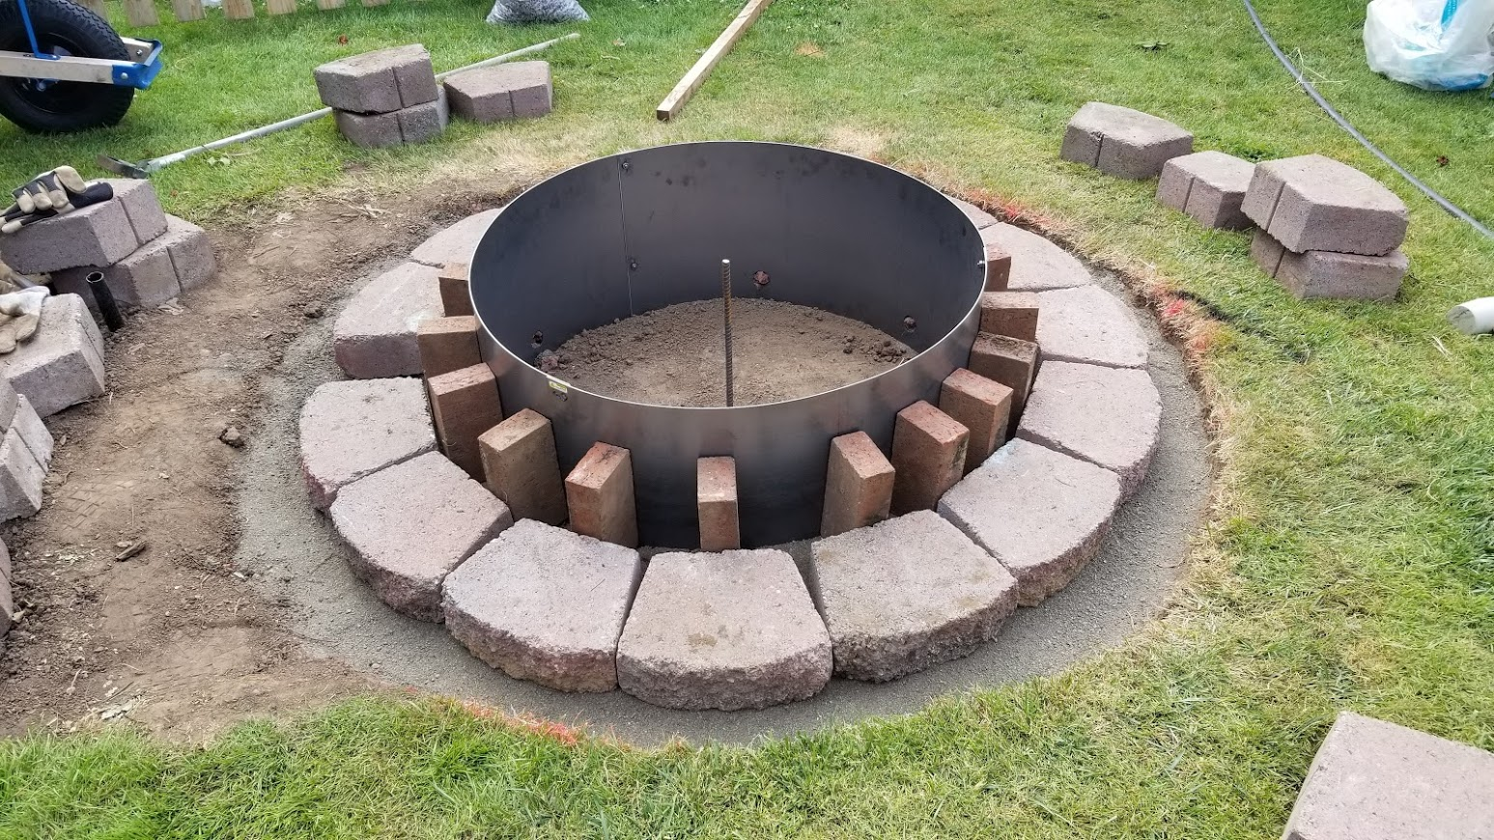
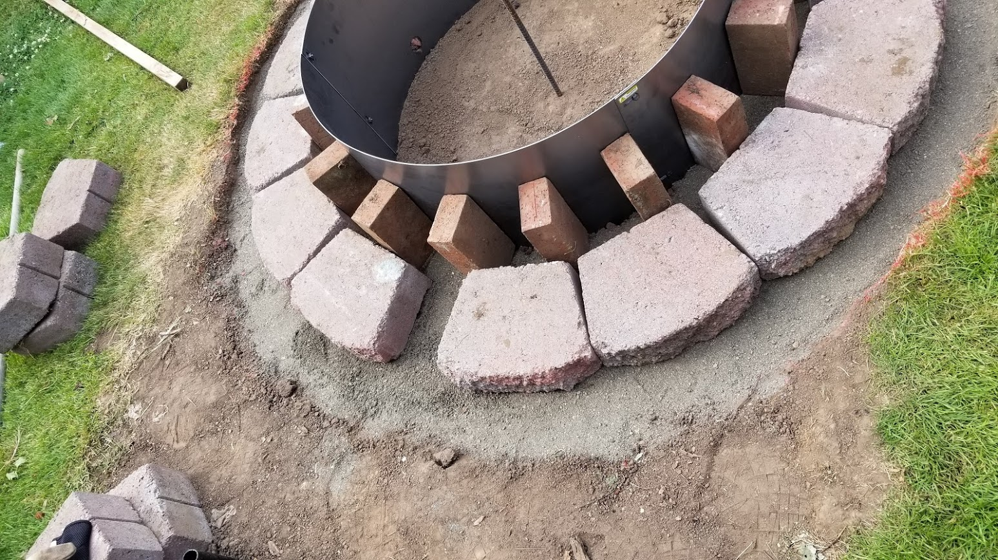

Slide 5
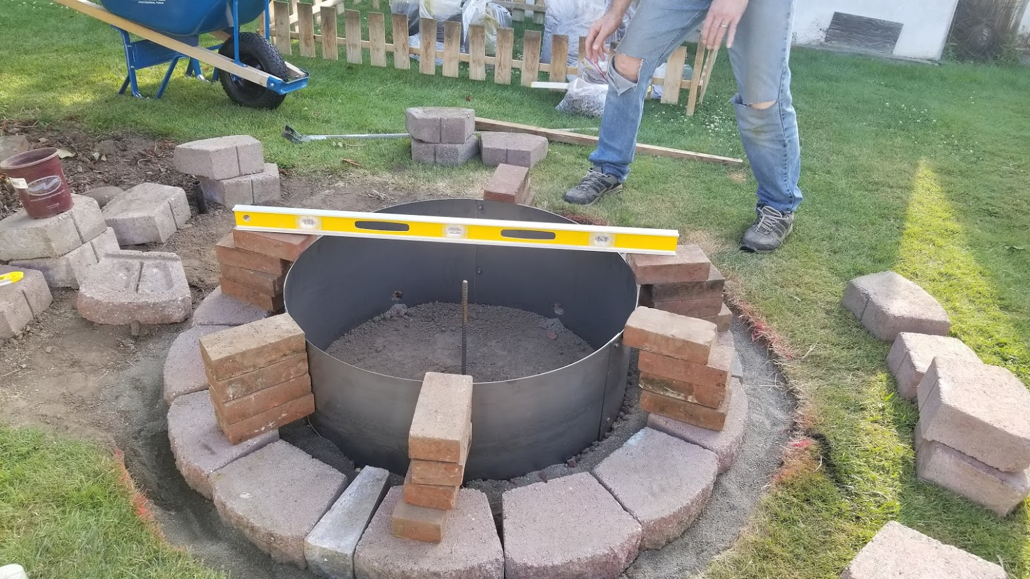
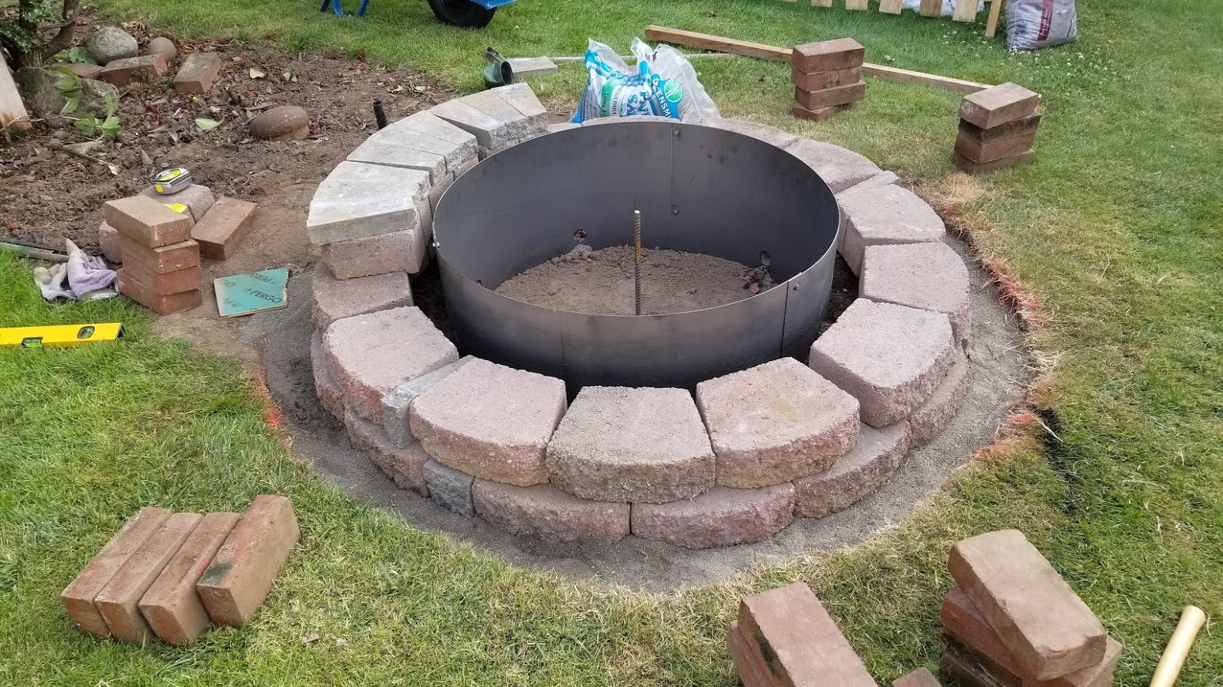

Slide 6
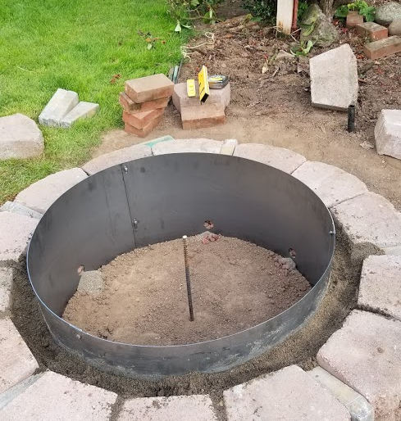
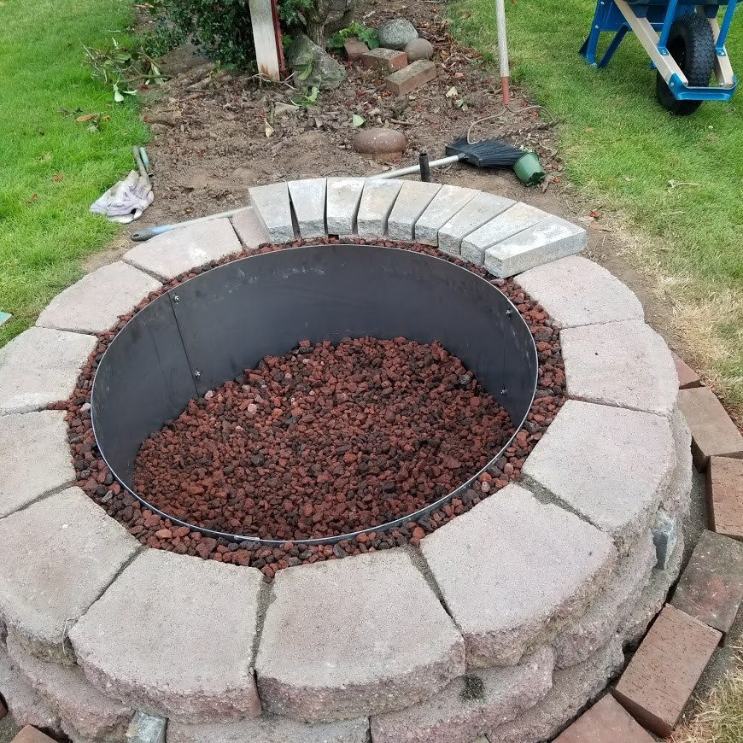

Slide 7
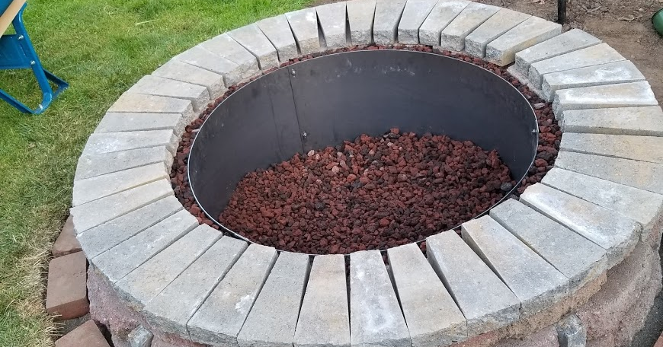

Slide 8
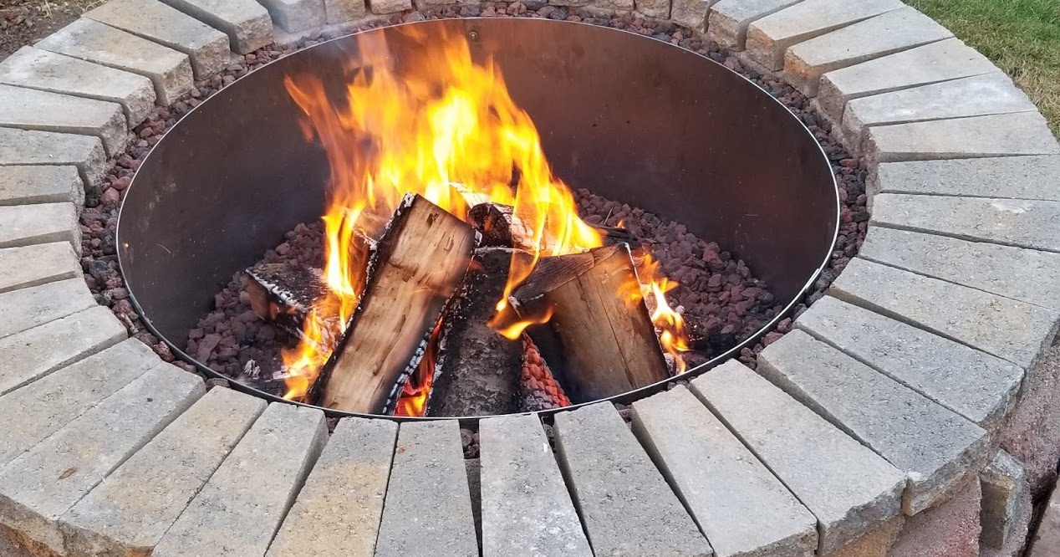
Notes:
I want a firepit so we have an outside place to hang out on summer evenings.
Give up the strawberry patch.

Slide 9
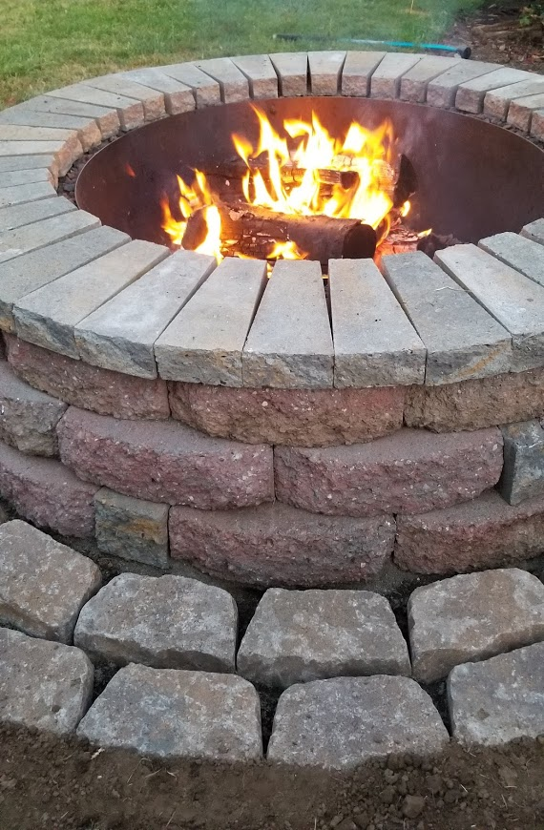
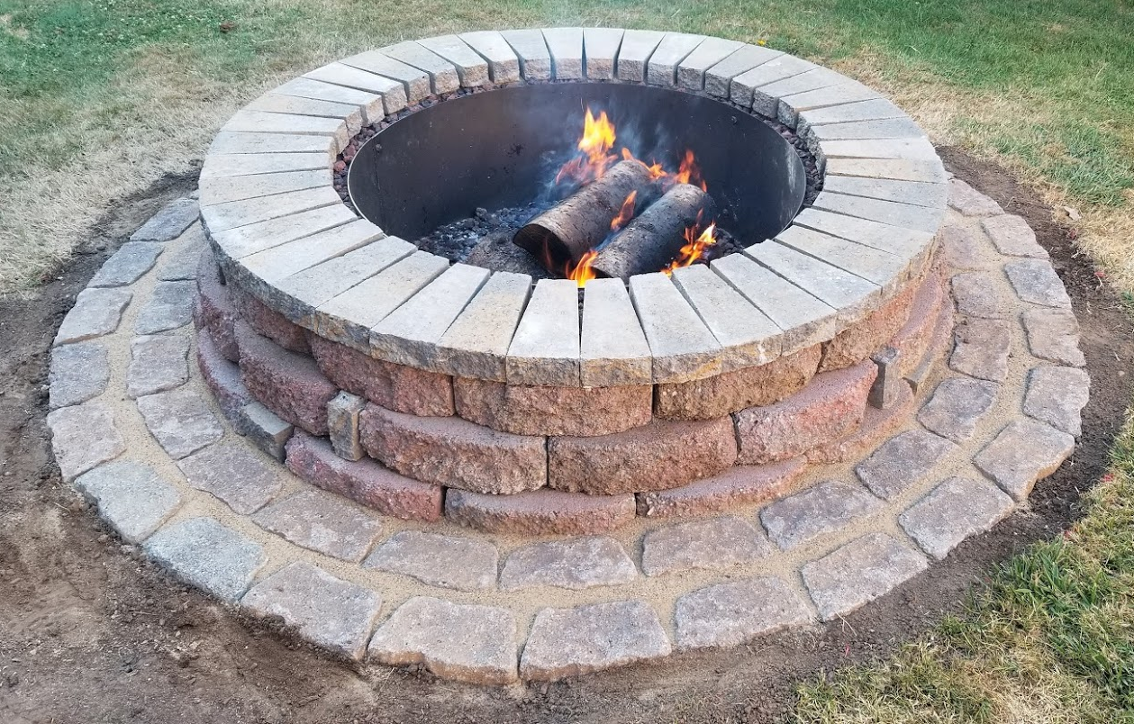
Notes:
I want a firepit so we have an outside place to hang out on summer evenings.
Give up the strawberry patch.

Slide 10
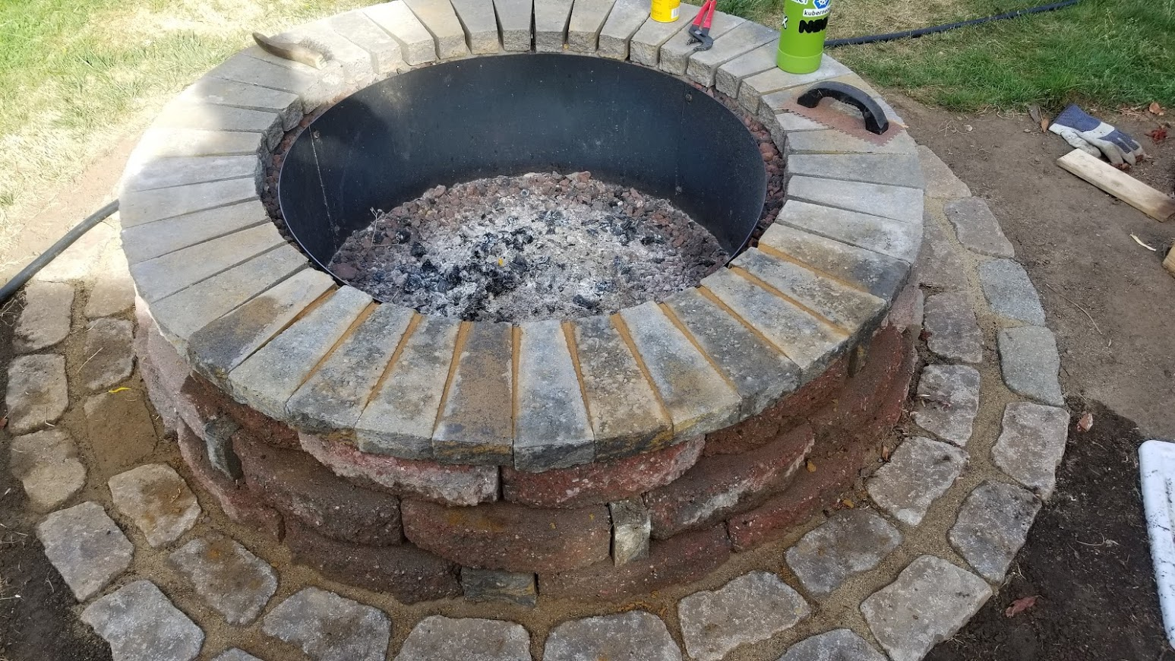
Notes:
I want a firepit so we have an outside place to hang out on summer evenings.
Give up the strawberry patch.

Slide 11
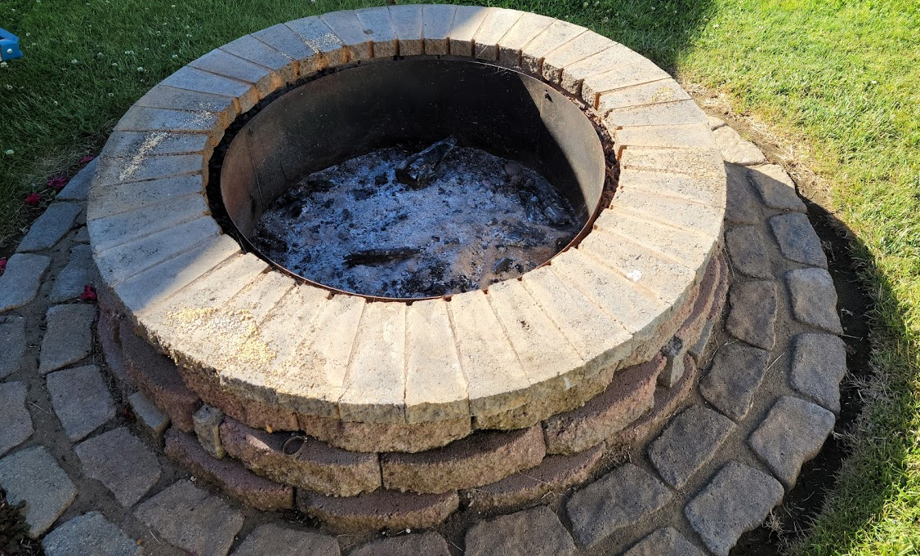
Notes:
I want a firepit so we have an outside place to hang out on summer evenings.
Give up the strawberry patch.

Slide 12
Effective vs Efficient
Effective
Efficient
producing the intended or expected results
doing the right things
comfortable
natural state for engineers
performing the best results with least time and effort
doing things right
uncomfortable
learned with effort and practice

Slide 13
Effective vs Efficient
Effective
Efficient
slow release time
Feedback later in the process
less rework
majority of reqs up front
fast release time
increased likelihood of success because of faster feedback
some rework and throw away code
some reqs are uncovered as a result of doing the work or feedback
Notes:
Infrastructure CI/CD work becomes essential

Slide 14
Questions
What is the bare minimum
Where’s the quality focus
What can be put off
Notes:
I want a firepit so we have an outside place to hang out on summer evenings.
Give up the strawberry patch.

